Slide 1
A decade of implementation science using mHealth to improve the HIV response –opportunities for the next phase
Richard T. Lester, MD, FRCPC
Associate Professor, Global Health,
Division of Infectious Diseases
Director, NGDI-UBC
richard.lester@ubc.ca
Methodological opportunities and challenges for implementation science to advance the HIV pandemic response
Non-Commercial SatelliteMOSA08
Monday 22 July, 18:30 - 20:30

Slide 2
Disclosures
Physician, Infectious Diseases, Vancouver General Hospital
Assistant Professor, Dept. Med., UBC
Director, Neglected Global Disease Initiative – UBC
Social enterprise:
Scientific Executive Director, WelTel International mHealth Society
Scientific Director, WelTel Incorporated (Inc.)
Research Funding from multiple government, philanthropic,
and Industry sources.
CIHR, Grand Challenges Canada, NIH, BCCDC Foundation
BCLA, CDC Foundation, UBC, PEPFAR
BMS, Gilead, Merck, Pfizer
Consultations/travel: WHO, ERS, OECD, China CDC, AAS
www.weltel.org
www.weltelhealth.com

Slide 3
Implementation Research: throughout the stages of evidence to impact at scale
Implementation
Goal

Slide 4
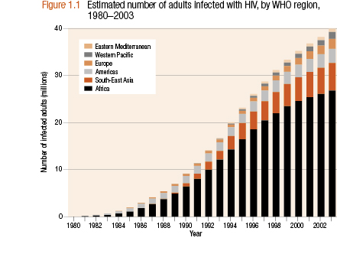
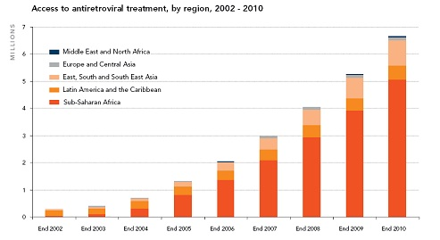
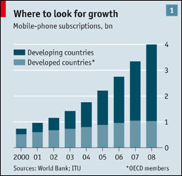
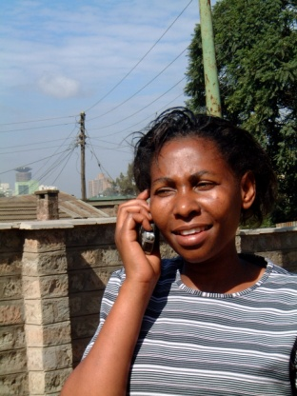
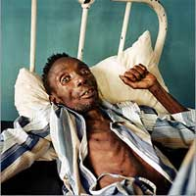
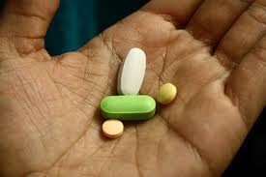
2005: WHO 3x5!
Problem: People living with HIV
Response: People on ART
People with mobile phones

Slide 5
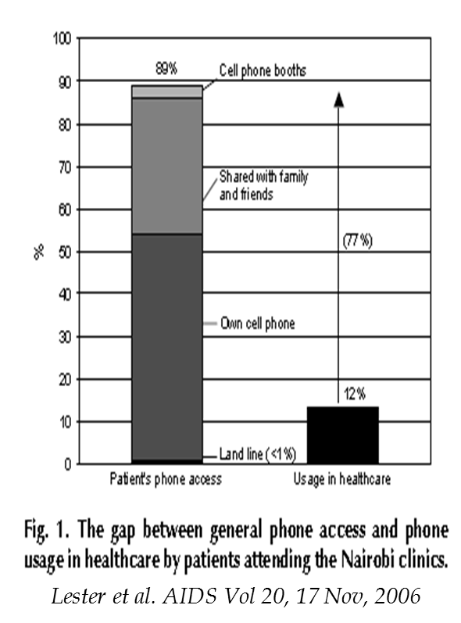
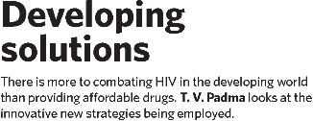
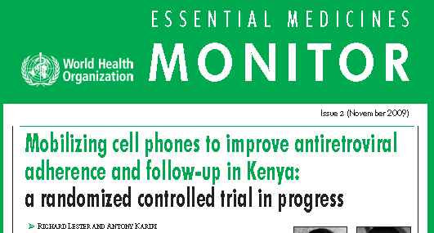
Origin of WelTel: 2005
Solution born in Kenya, evolving since 2005

Slide 6
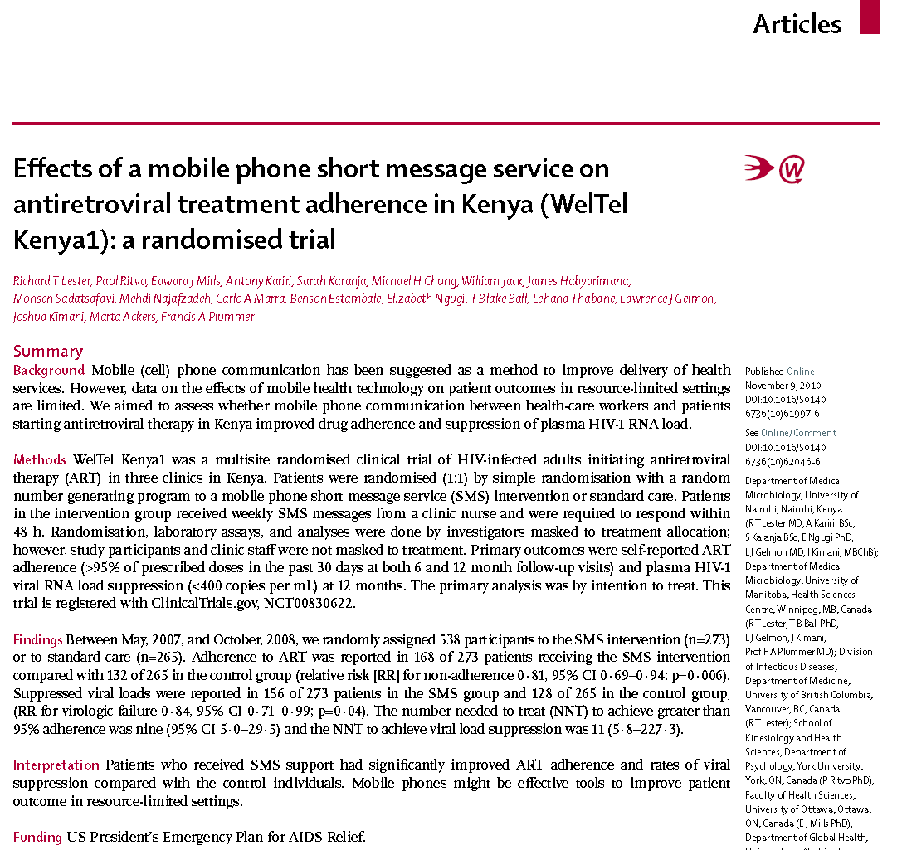
Nov 27, 2010
Consolidated ARV guidelines, June 2013
9.2.2 Interventions to optimize adherence to ART (part 2)
Operations and service delivery
Topic: Interventions to optimize adherence to ART
Recommendations:
Mobile phone text messages could be considered as a reminder tool for promoting adherence to ART as part of a package of adherence interventions
(strong recommendation, moderate-quality evidence).
*24% relative improvement in achieving 95% adherence
*19% relative improvement in achieving viral suppression

Slide 7
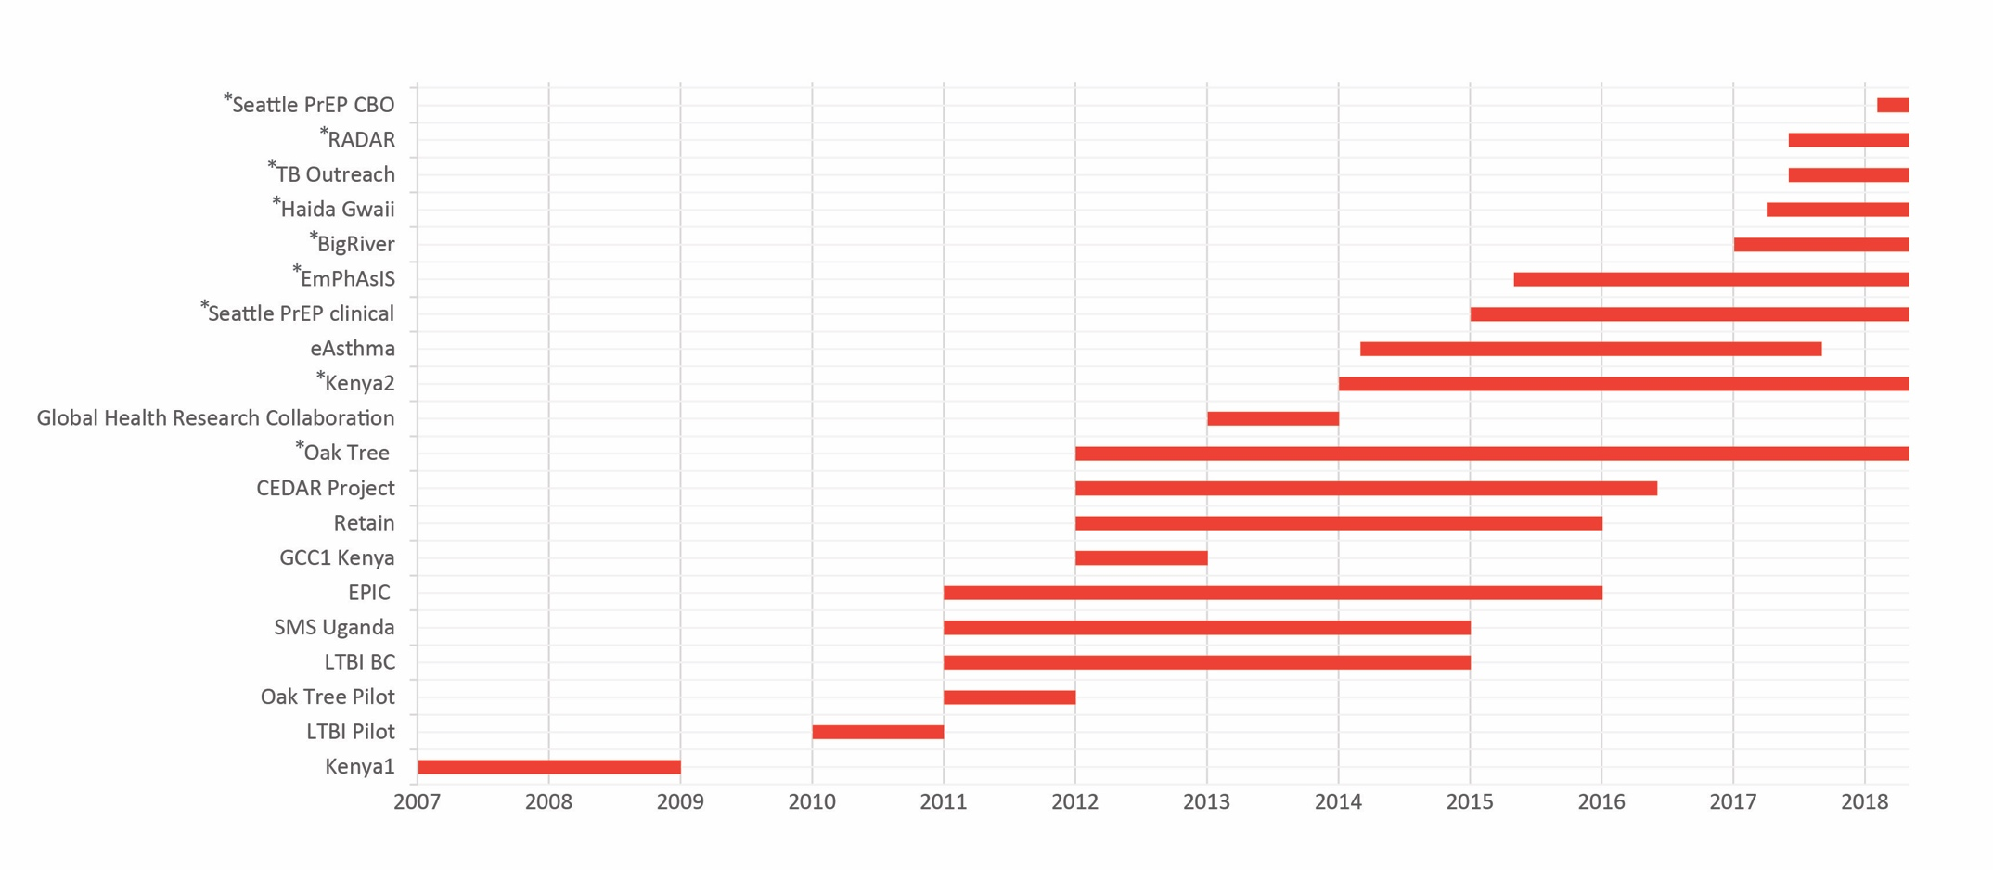
A Program of mHealth Research
7 RCTs
Mixed methods
Implementation science
HIV, PMTCT, PrEP
TB, MNCH
Asthma
Primary care
Hospital discharge
Adaptive mHealth management platform for many populations, health conditions, and global settings
Over 6 RCTs conducted or underway plus qualitative and implementation science (HIV, TB, asthma, primary care)

Slide 8
mHealth adherence: cost-effective
Medicine 2017:
Very cost-effective at $15 pppy
mHealth Summit 2011:
Cost saving to PEPFAR within 3 years
Figure . Costs of SMS Intervention vs. Costs Savings over 3 years for PEPFAR Global Cohort on ART (2.485M patients)
Bella Hwang, mHealth Summit 2011
Anik R. Patel, RPh, MHA^{1,2} Jason Kessler, MD, MPH² R. Scott Braithwaite, MD, MSc² Kimberly A. Nucifora, MSc² Harsha Thirumurthy, PhD,³ Qinlian Zhou, PhD² Richard T. Lester, MD¹ Carlo Marra, PharmD, PhD⁴

Slide 9
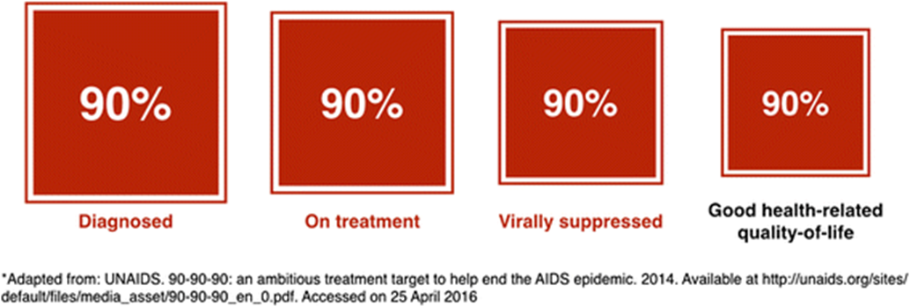
Quality of Life

Slide 10
Differentiated Care (Precision health)
Natural Language Processing
CAHR 2018
https://www.msfhr.org/smart-text-analytic-tools-stat-analysis-patient-centred-communications-strengthen-health-systems-bc

Slide 11
Summary of Evidence
Improves Adherence
ART
PrEP
Cost-effective
Quality of Life
Differentiated Care
?

Slide 12
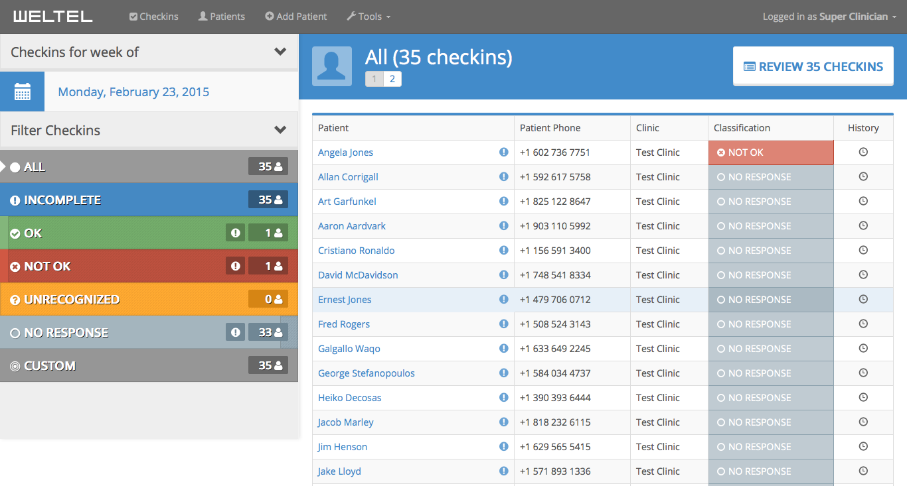
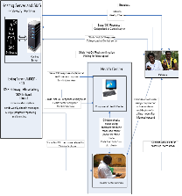
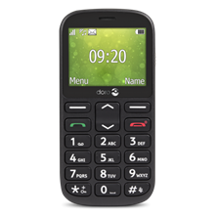
Product: WelTel System Diagram 2019
Algorithms sort patient responses into easy workflows
Powerful, easy-to-use features
For end-to-end patient care
Usable with any device
or
Provider
Video
SMS, voice
Patient
12
A social enterprise: www.weltelhealth.com www.weltel.org

Slide 13
Implementation Research: mCFIR Tool

Slide 14
Modified CFIR (mCFIR)
Domains & Constructs
Participants
Outputs
Scoring
- performance
- importance
Narrative
- qualitative
- discussion
Feedback
- ranking
- visualizations
- statistics
R Lester et al.
https://cfirguide.org/

Slide 15
“All I’m saying is now is the time to develop the technology to deflect an asteroid.”
90-90-90 is almost here!
Let’s implement and fund the stuff we know that works

Slide 16
Thank you!
Richard T. Lester, MD, FRCPC
Associate Professor, Global Health, Division of Infectious Diseases
Director, NGDI-UBC
Richard.lester@ubc.ca
partners
IAS 2019
Mexico City

Slide 17
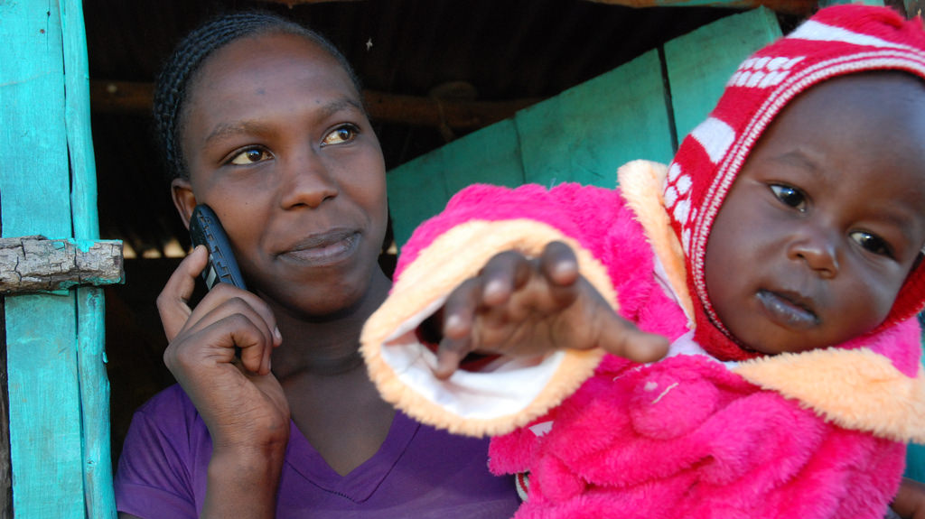
#1:Reach

